Slide 1
Analyzing Seattle terry stops

Slide 2
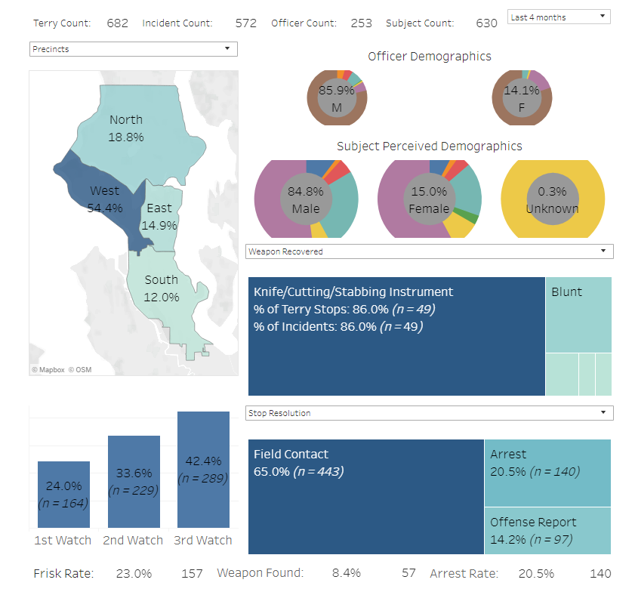
Start by cleaning the dataset
Imagine provided by the seattle.gov terry stops dashboard.

Slide 3
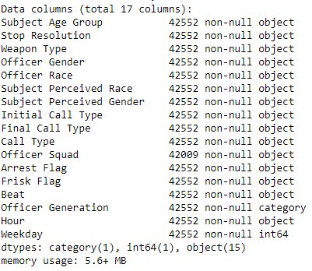
The new dataset:
-Duplicates removed
-year of officer birth binned into decades
-arrest time binned into hours
-arrest date binned into days of week
-Subject ID, Go Num, Terry stop ID, Precinct and Sector removed
-all data one hot encoded into categories

Slide 4
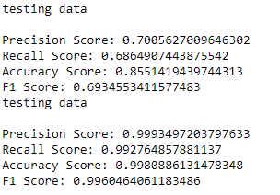
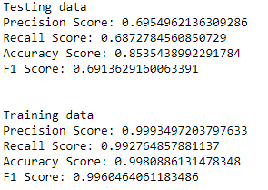
Choosing an algorithm
First attempt was K Nearest Neighbor, which failed due to the size of the dataset
Next was a basic Decision tree. Note that a visualization is difficult due to the hundreds of columns present.
Both entropy and gini criteria were used
All of the training metrics were 99+, while the testing data was not.
Clear case of overfitting, the model needs to be redone

Slide 5
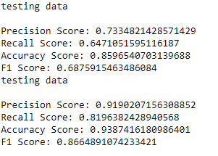
Best Decision Tree
A grid search finds that the best factors are: criterion=gini, max_depth=none, min_samples_leaf=2,min_samples_split=10
Much better metrics! Now we check if we can’t improve them

Slide 6
Which metric to use to score
Accuracy was chosen as the preferred scoring tool rather than precision or recall. Precision is typically used to minimize false positives, recall is used to minimize false negatives. Since there is no particular reason to prefer one over the other, accuracy scoring was selected.

Slide 7
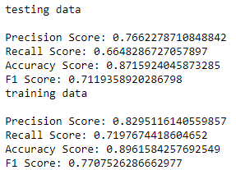
Playing with Decision Trees
Several different types of decision trees were used, included bagged trees, random forests, and extreme gradient boosted trees. The best was an XGB Classifier the parameters:
'learning_rate': 0.2, 'max_depth': 6, 'min_child_weight': 2, 'n_estimators': 100, 'subsample': 0.7

Slide 8
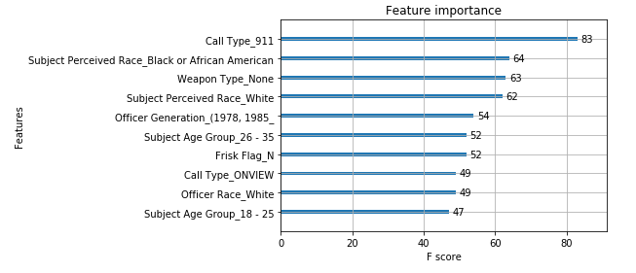
Feature importance
What were the top 10 features determining if a person was arrested during the terry stop?

Slide 9
Call type - 911
It makes sense that this is the most important feature that determines an arrest. If someone is calling in police, it is quite likely that the person is correct in assuming that a crime is taking place (or at the very least, the responding officers would be more inclined to think so).

Slide 10
Race
Unfortunately, as one might have anticipated, whether the person is White or Black is very important whether or not an arrest is made.

Slide 11
Additional features
People without a weapon were far less likely to be arrested. The oldest officers were most likely to make an arrest. Young people between 18 and 35 were most likely to be arrested.

Slide 12
Final analysis
Black people were 15.4% more likely to be arrested during a stop.
The XGB classifier was tested on data where all individuals had their races flipped: black people were replaced with white people and vice versa, while all other factors were kept the same.
Black-turned-white people were arrested 14.6% less often
White-turned-black people were arrested 13.1% less often
BtW people were arrested at the exact same rate as the original group of white people, which makes total sense. However, WtB people had their arrest rate drop as well! This is a very bizarre finding. No interpretation of this result that conforms with common understanding of police-race relations comes to mind

Slide 13

Gender
Finally, gender was surprisingly not included in the top 10 features. However, that is not to say that the gender disparity is not significant: as one can see in the original dataset, black women are more likely to be arrested than the average man.

